Slide 1

PYTHON PROGRAMMING & DATA SCIENCE
Multi Layer Perceptron

Slide 2
Multi Layer Perceptron
Multi-Layer perceptron defines the most complex architecture of artificial neural networks. It is substantially formed from multiple layers of the perceptron.
MLPs are the base of deep learning technology. It belongs to a class of feed-forward neural networks having various layers of perceptrons. These perceptrons have various activation functions in them.
MLPs also have connected input and output layers and their number is the same. Also, there's a layer that remains hidden amidst these two layers.
MLPs are mostly used to build image and speech recognition systems or some other types of the translation software.

Slide 3
Multi Layer Perceptron
The working of MLPs starts by feeding the data in the input layer. The neurons present in the layer form a graph to establish a connection that passes in one direction.
The weight of this input data is found to exist between the hidden layer and the input layer. MLPs use activation functions to determine which nodes are ready to fire. These activation functions include tanh function, sigmoid and ReLUs.
MLPs are mainly used to train the models to understand what kind of co-relation the layers are serving to achieve the desired output from the given data set.
See the below image to understand better….

Slide 4
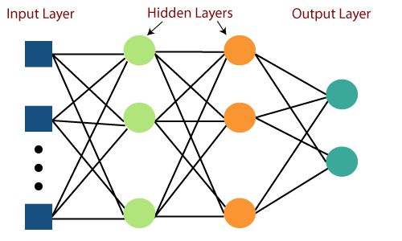
Multi Layer Perceptron

Slide 5
Multi Layer Perceptron
The algorithm for the MLP is as follows:
Just as with the perceptron, the inputs are pushed forward through the MLP by taking the dot product of the input with the weights that exist between the input layer and the hidden layer (W­­­H). This dot product yields a value at the hidden layer. We do not push this value forward as we would with a perceptron though.
MLPs utilize activation functions at each of their calculated layers. There are many activation functions to discuss: rectified linear units (ReLU), sigmoid function, tanh. Push the calculated output at the current layer through any of these activation functions.

Slide 6
Multi Layer Perceptron
Once the calculated output at the hidden layer has been pushed through the activation function, push it to the next layer in the MLP by taking the dot product with the corresponding weights.
Repeat steps two and three until the output layer is reached.
At the output layer, the calculations will either be used for a backpropagation algorithm that corresponds to the activation function that was selected for the MLP (in the case of training) or a decision will be made based on the output (in the case of testing)

Slide 7
Multi Layer Perceptron
In the world of deep learning, TensorFlow, Keras, Microsoft Cognitive Toolkit (CNTK), and PyTorch are very popular.
Most of us may not realise that the very popular machine learning library Scikit-learn is also capable of a basic deep learning modelling.

Slide 8
Multi Layer Perceptron
Salient points of Multilayer Perceptron (MLP) in Scikit-learn
There is no activation function in the output layer.
For regression scenarios, the square error is the loss function, and cross-entropy is the loss function for the classification
It can work with single as well as multiple target values regression.
Unlike other popular packages, likes Keras the implementation of MLP in Scikit doesn’t support GPU.
We cannot fine-tune the parameters like different activation functions, weight initializers etc. for each layer.

Slide 9
MLP Example - Classification Example
In Scikit-learn “ MLPClassifier” is available for Multilayer Perceptron (MLP) classification scenarios.
Step1: Like always first we will import the modules which we will use in the example. We will use the Iris database and MLPClassifierfrom for the classification example.
from sklearn.datasets import load_iris from sklearn.neural_network import MLPClassifierfrom sklearn.model_selection import train_test_splitfrom sklearn.preprocessing import StandardScaler import pandas as pd from sklearn.metrics import plot_confusion_matrix import matplotlib.pyplot as plt

Slide 10
MLP Example
Step 2: In separate data frames “X” and “y”, the values of the independent and dependent features are stored.
iris_data = load_iris() X = pd.DataFrame(iris_data.data, columns=iris_data.feature_names) y = iris_data.target

Slide 11
MLP Example
Step 3: Similar to the regression example above we will split the dataset into train and test dataset. We have reserved 20% of the dataset for checking the accuracy of the trained model. Independent train and test dataset are further scaled to make sure that the input data is standard normally distributed are centred around zero and have variance in the same order.
X_train, X_test, y_train, y_test = train_test_split(X,y,random_state=1, test_size=0.2) sc_X = StandardScaler() X_trainscaled=sc_X.fit_transform(X_train) X_testscaled=sc_X.transform(X_test)

Slide 12
MLP Example
Step 4: In the below code, we have modelled four hidden layers with different neurons in each layer. Considering the input and output layer, we have a total of 6 layers in the model. In case any optimiser is not mentioned then “Adam” is the default optimiser.
clf = MLPClassifier(hidden_layer_sizes=(256,128,64,32),activation="relu",
random_state=1).fit(X_trainscaled, y_train) y_pred=clf.predict(X_testscaled) print(clf.score(X_testscaled, y_test))

Slide 13
MLP Example
The classifier shows quite a high score for the test data. It is important to understand the areas in which the classification model is making an error to make a full sense of model accuracy.
Step 5: We will draw a confusion matrix to understand the classifications which are made incorrect by the model.
fig=plot_confusion_matrix(clf, X_testscaled, y_test,display_labels=["Setosa","Versicolor","Virginica"]) fig.figure_.suptitle("Confusion Matrix for Iris Dataset") plt.show()

Slide 14
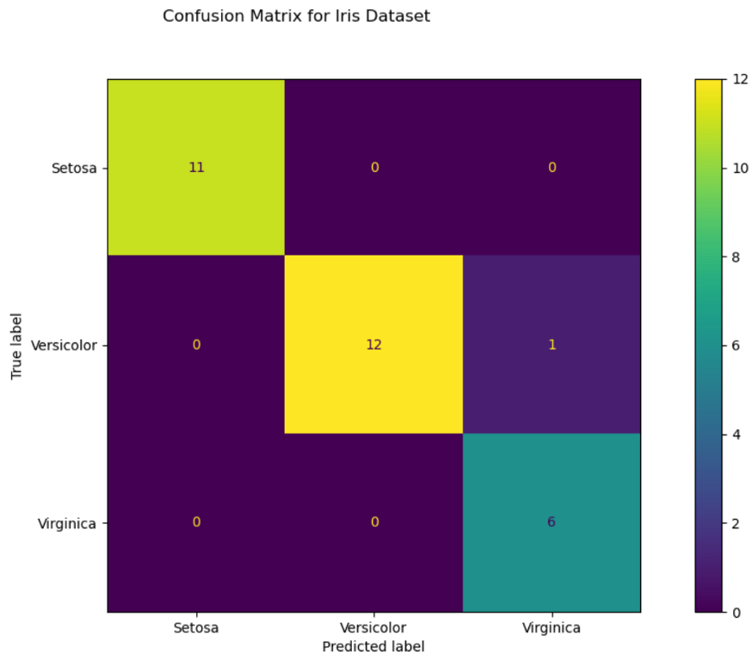
MLP Example

Slide 15
THANK YOU

